Slide 1
Patient Monitoring System
Prof. Jonathan Lee
CSIE Department
National Taiwan University

Slide 2
Requirement Statements
Patients in an intensive-care ward in a hospital are monitored by electronic analog devices attached to their bodies by sensors of various kinds.
Through the sensors the devices measure the patients’ vital factors: one device measure pulse rate, another blood pressure, another temperature, and so on.
A program is needed to read the factors, at a frequency specified for each patient, and store them in a database.
The factors read are to be compared with safe ranges specified for each patient, and readings that exceed the safe ranges are to be reported by alarm messages displayed on screen of the nurses station. An alarm message is also to be displayed if any analog device falls.

Slide 3
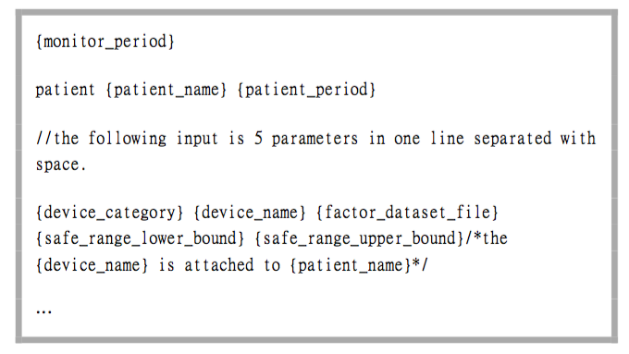
SPEC - Input

Slide 4
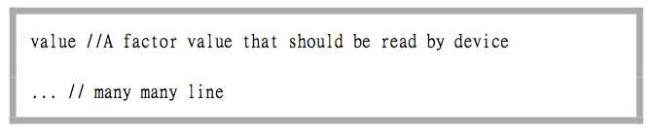
SPEC - factorDataset format

Slide 5
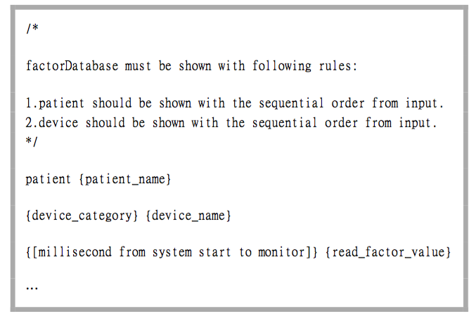
SPEC - factorDatabase format

Slide 6
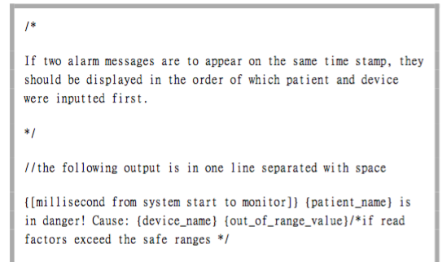
SPEC - Output (1)

Slide 7
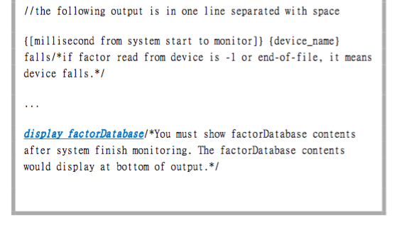
SPEC - Output (2)

Slide 8
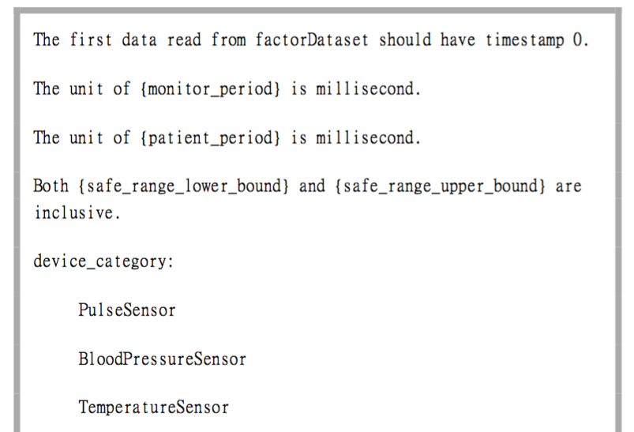
SPEC - Comment (1)

Slide 9
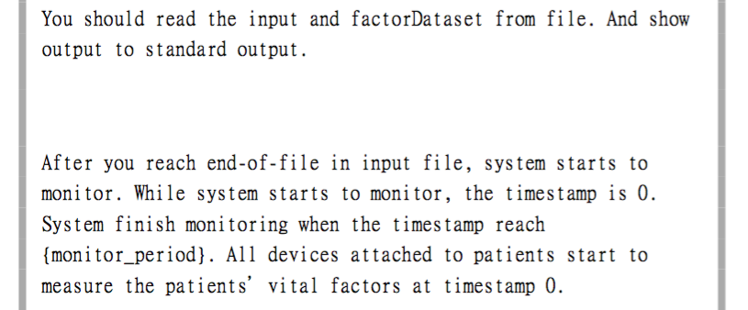
SPEC - Comment (2)

Slide 10
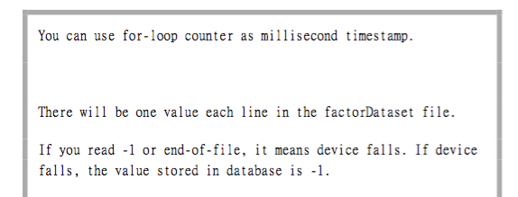
SPEC - Comment (3)

Slide 11
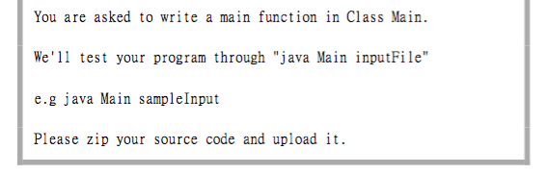
SPEC - Comment (4)

Slide 12
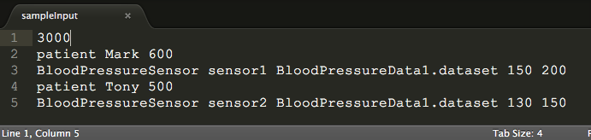
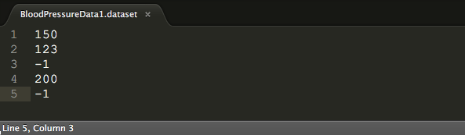
SPEC – Sample Input (File)

Slide 13
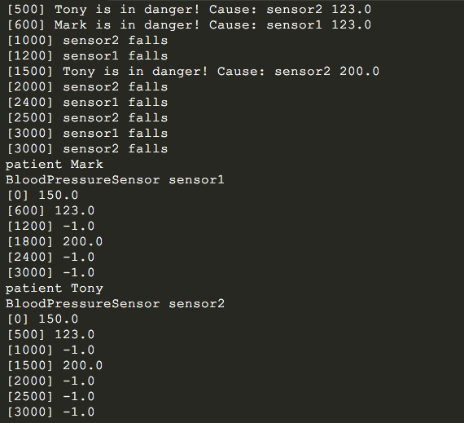
SPEC – Sample Output (STD Output)

Slide 14
Upload
Please zip your source code and email to the following email address:
brian50208lee@gmail.com (Only the red part is digit)
主旨: [學校名稱] Patient Monitoring System 程式作業
Deadline: 01/19 17:00
We will test your program by running the following commands:
(unzip)
(cd in your folder)
javac *.java
java Main [SomeInputFile]

